Slide 1
Assignment on Sample Superstore (Case Study)
Submitted By: Pooran Pragnya
November Batch (BDS)

Slide 2
CASE 1:
Case Study: Your manager asked you to look into the overall sales and profitability for the company and to identify key areas for the improvement.
Dataset: The sample –Superstore data set comes with Tableau. It contains information about products and so on that can be used to identify key areas for the improvement within the fictious company.

Slide 3
Scenarios for the case study
Find the sales for every year.
Find the highest sales and show the view in bar graph.
Add the label to your view.
Find the category wise sales for every year.
Which category has highest sales in the year 2020 and 2021?
Based on the analysis of the year 2020 and 2021 give some suggestions to improve sales in the year 2022
Display subcategory and find some insights from the view about max and min sales under each subcategory.
Check the Tooltip.
In your bar graph, present subcategory under each category using color card.

Slide 4
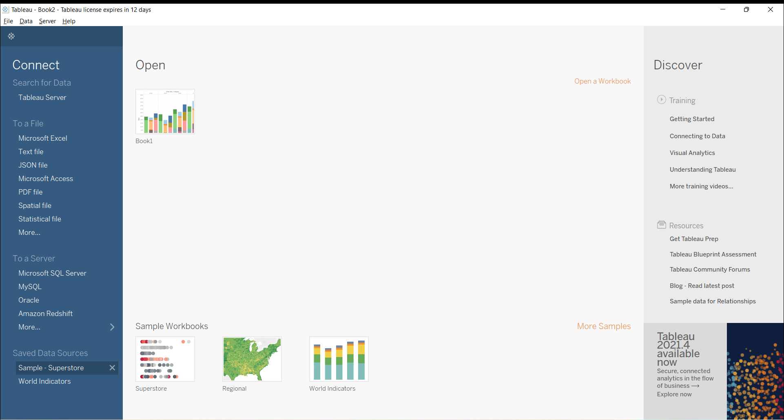

Slide 5
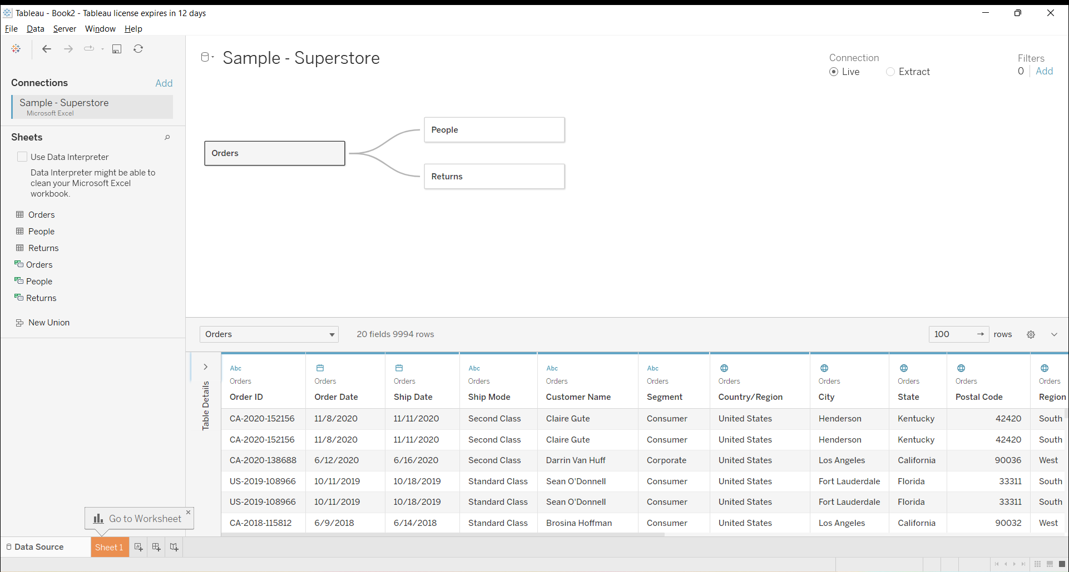

Slide 6
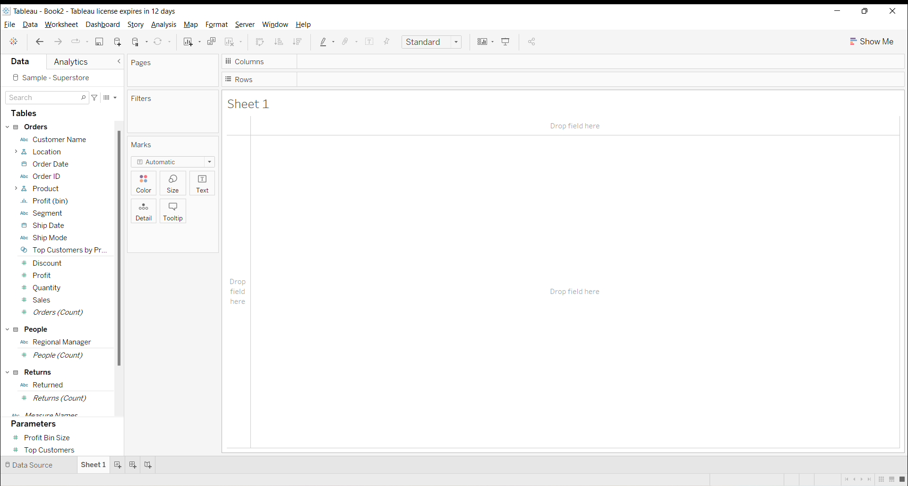

Slide 7
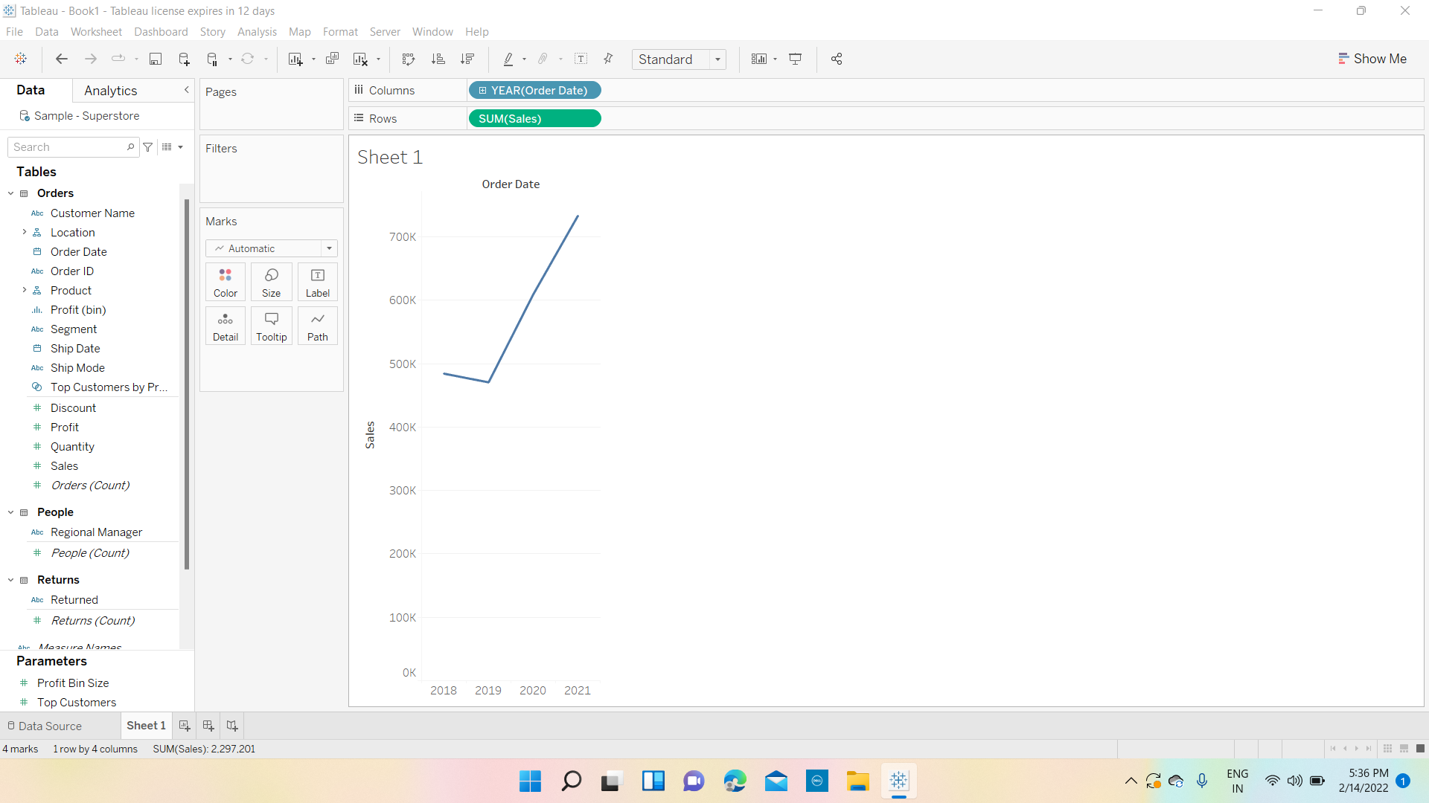
1. Find the Sales for Every year

Slide 8
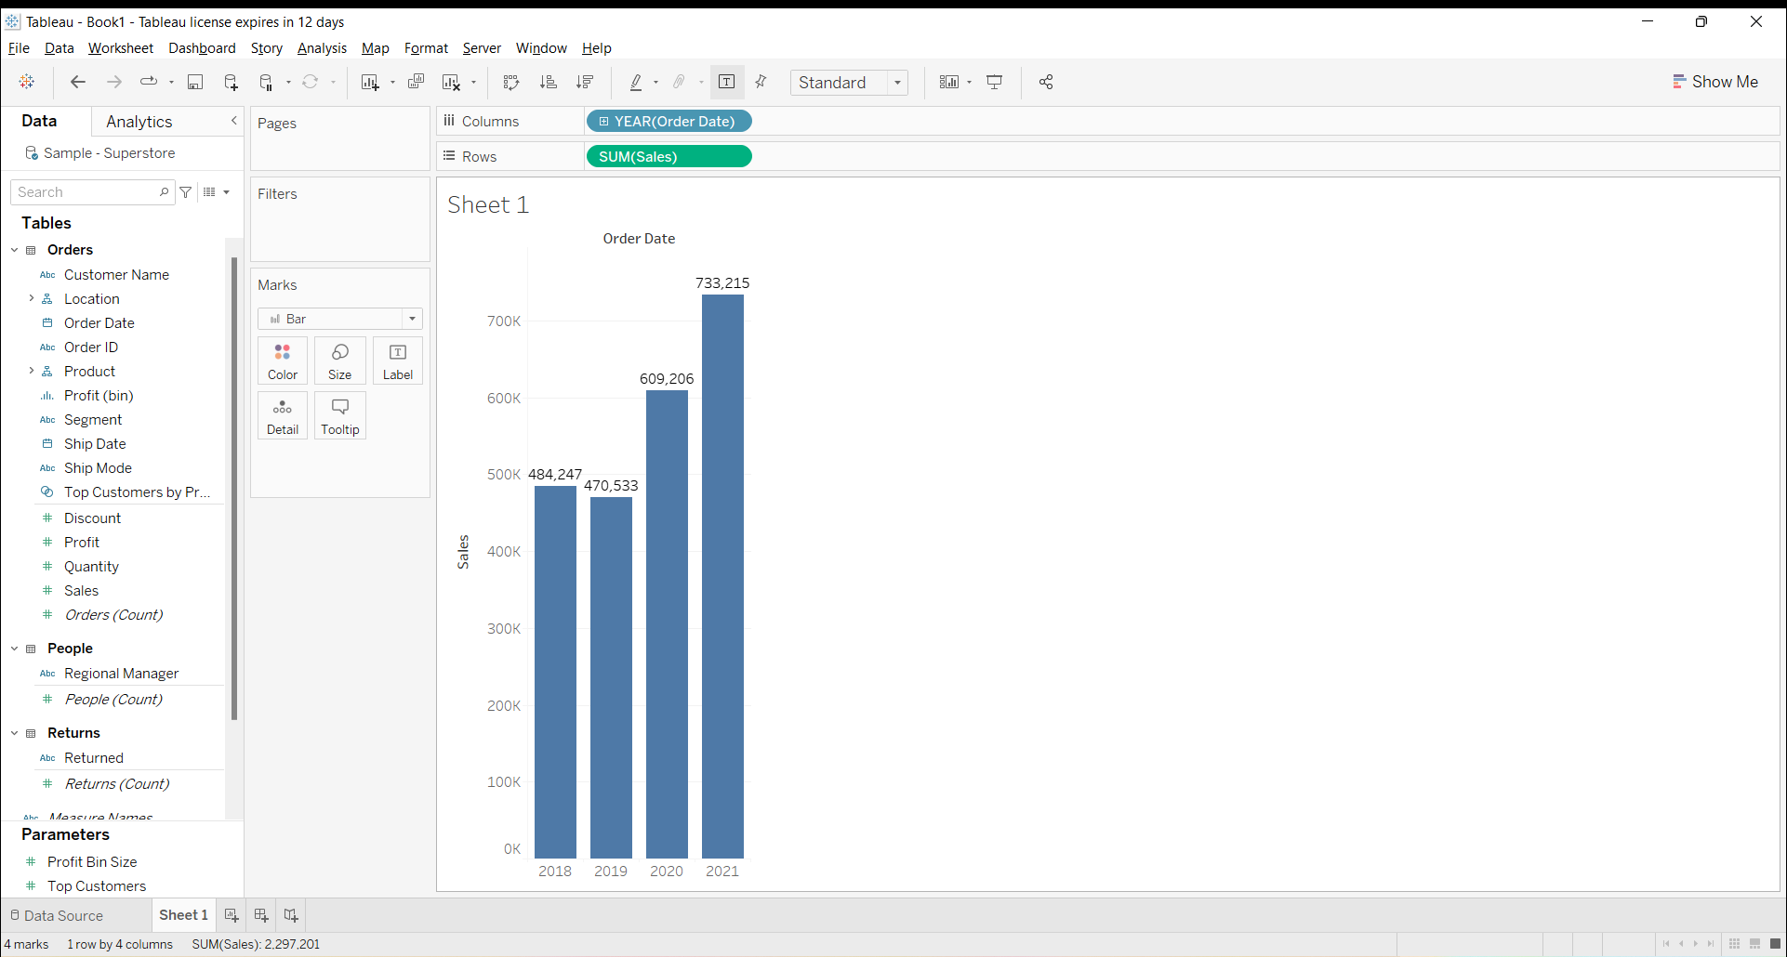
2. Find the highest sales and show the view in bar graph

Slide 9
3. Add Label to your view

Slide 10
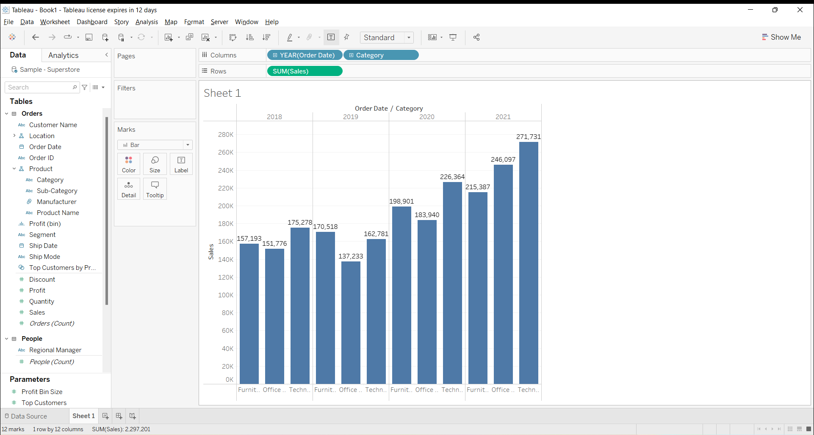
4. Find the category wise sales for every year

Slide 11


5. Which category has highest sales in the year 2020 and 2021?

Slide 12
6. Based on the analysis of the year 2020 and 2021 give some suggestions to improve sales in the year 2022
Ways :
Improving on category which have poor performance (like furniture and office tools)
focusing more on technology based category(as there is increasing demand for that category).

Slide 13
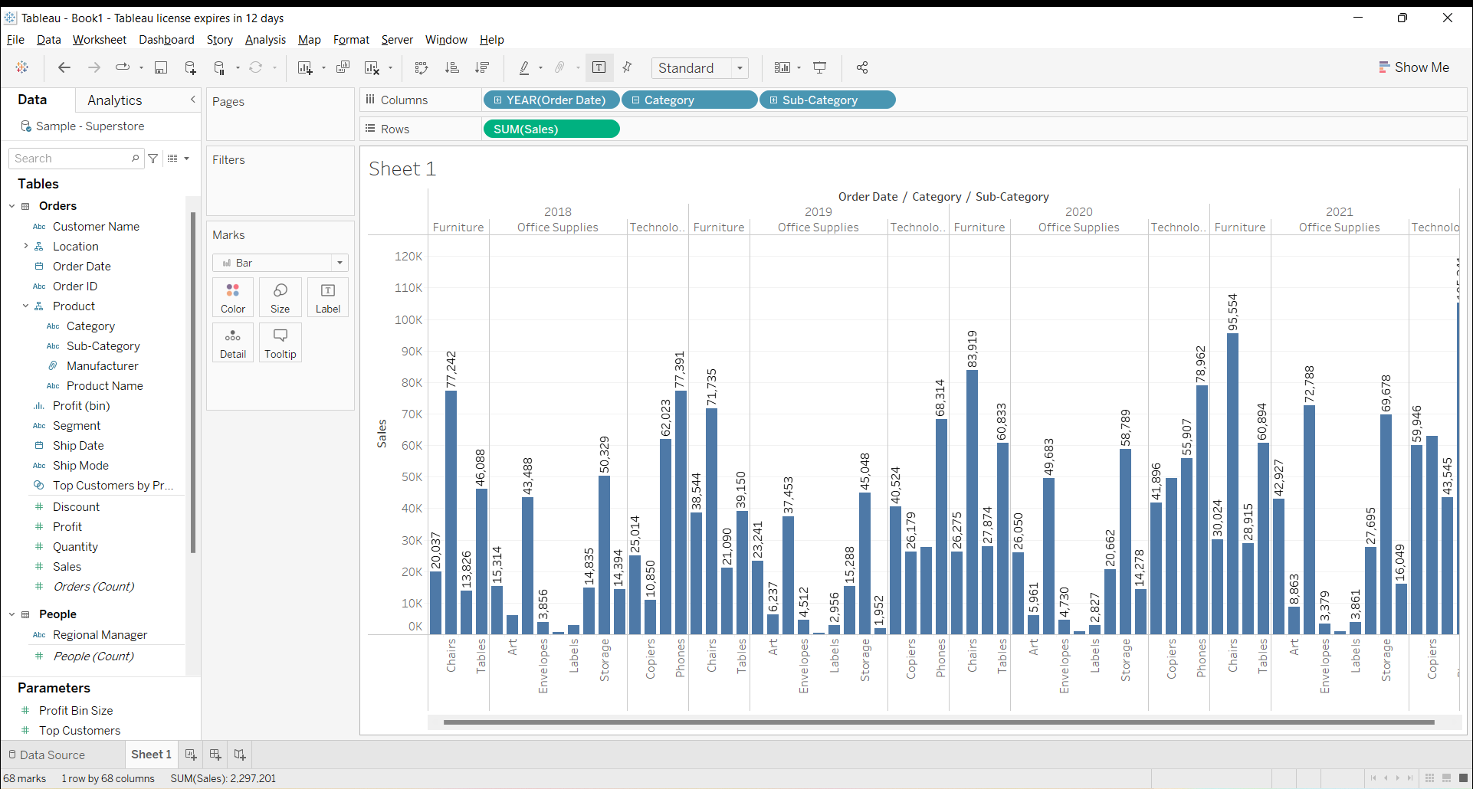
7. Display subcategory and find some insights from the view about max and min sales under each subcategory

Slide 14
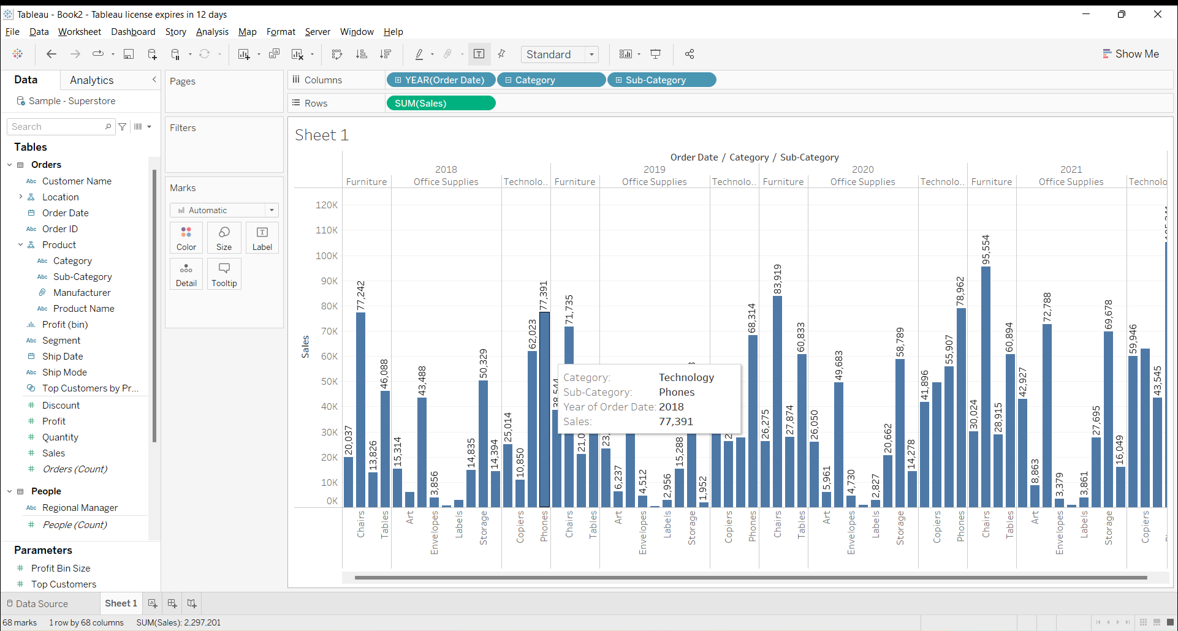
8. Check the Tooltip

Slide 15
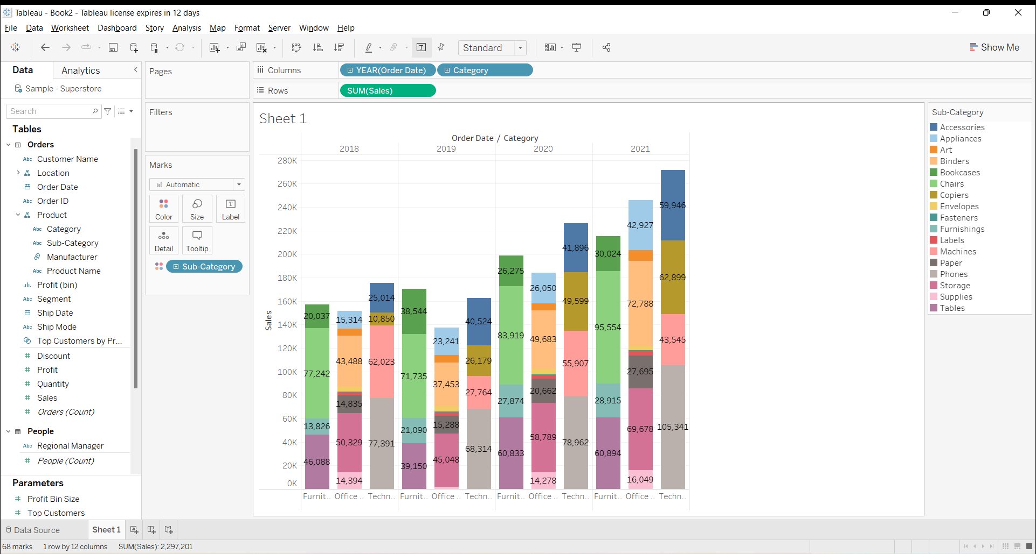
9. In your bar graph, present subcategory under each bar of category using color card.

Slide 16
